Slide 1
Is Proud to Present “Faith Over Fear” Tom Huch, Artist
IN WATSON HALL AT LOVERS LANE UNITED METHODIST CHURCH 9200 Inwood Rd, Dallas, TX 75220 corner of Northwest Highway and Inwood Rd enter at Entrance A From April 15, 2021 through July 1, 2021
The ArtReach Gallery
Is underwritten by

Slide 2
About Tom Huch, Artist
Artist and architect Tom Huch has lived in Dallas, TX area for over thirty years creating unique and vibrantly colorful images which challenge the mind and spirit.
Tom’s artwork is displayed in private homes, galleries, churches and schools throughout the U.S. A few of these pieces include Acts of Kindness (Downtown Women's Center, Amarillo, TX), The Prayer of St. Francis (Christian schools in Jackson, MS and St. Paul, MN), and in Anglican Church, Rockwall, First Christian Church, Rowlett, as well as a large number of other works at Canyon Creek Presbyterian Church, Woodcreek Church and First Presbyterian Church, Richardson. His painting Overcoming Hatred and Hope was accepted into the permanent collection of the Dallas Holocaust Museum and Center for Education and Tolerance in 2011. Tom is a member of Faith Artists, Dallas.

Slide 3
The Lovers Lane Foundation is a separate 501(c)(3) tax exempt charitable entity that exists to support Lovers Lane United Methodist Church and its Ministries and its Members. The ArtReach Gallery is one of the ministries it supports through the Eitzen-Jones Memorial Fund for the Visual Arts, one of 42 Endowments of the Lovers Lane Foundation. The ArtReach Gallery is managed by the Visual Arts Committee of the Lovers Lane Foundation. The current members of the Visual Arts Committee are:
jkcy49@gmail.com
jkcy49@gmail.com
Judy Campbell | Donna Chambers
Marilyn Jones | Anabel Leigh
Margaret Mall | Judy Young
If you are interested in showing in the ArtReach Gallery
Or if you are interested in serving on the Visual Arts Committee
Contact
Judy Young or Margaret Mall
At
jkcy49@gmail.com or margaret@calligraphyartstudio.com
ENJOY THE EXHIBIT

Slide 4
See something you like? If you are interested in purchasing a piece of artwork, please contact Paul Ditto, Executive Director of the Lovers Lane Foundation
at 214-706-9561
or email him at pditto@llumc.org
For all purchases, sales tax of 8.25% must be added.
25% of the sales price will go to
the Visual Arts Endowment of the Lovers Lane Foundation and the artist will receive 75% of the sales price. Purchased pieces must remain up in the exhibit until the end of the exhibit (July 1). Purchased pieces need to be picked up the morning of Thursday, July 1. If you cannot pick up your purchased piece on that date, please check with Paul Ditto for alternative arrangements. If the piece needs to be shipped, we can make arrangements for that and advise you of additional costs.

Slide 5
Here is the Exhibit “Faith Over Fear” Tom Huch, Artist
Enjoy

Slide 6
Media: Latex Paint and Caulk Size: 24" x 36” Sale Value: $325.00

Slide 7
Media: Latex Paint and Caulk Size: 24" x 36” Sale Value: $350.00

Slide 8
Media: Latex Paint and Caulk Size: 24" x 36“ Sale Value: $375.00

Slide 9
Media: Latex Paint and Caulk Size: 24" x 36“ Sale Value: $375.00

Slide 10
Media: Latex Paint and Caulk Size: 24" x 36" Sale Value: NFS

Slide 11
Media: Latex Paint and Caulk Size: 24" x 36" Sale Value: $380.00

Slide 12
Media: Latex Paint and Caulk
Size: 24” x 36”
Sale Price: $260.00

Slide 13
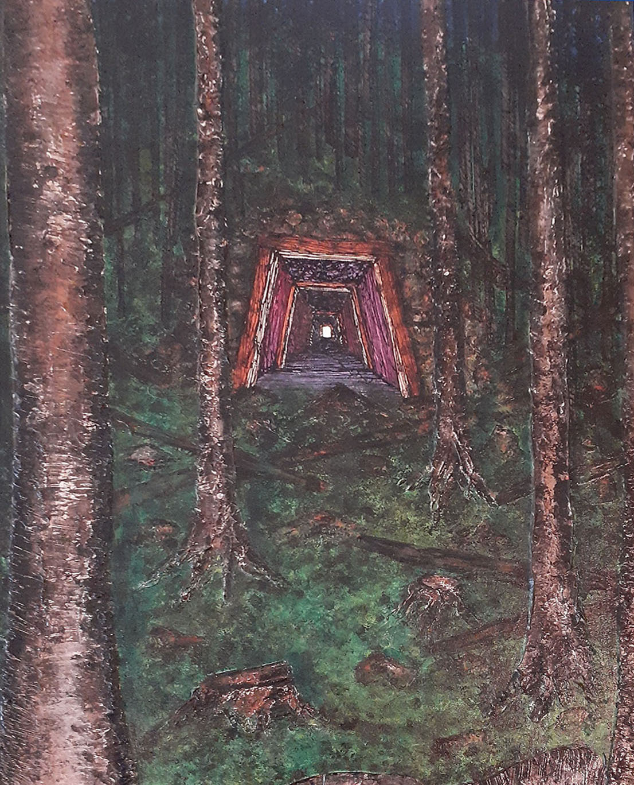
Media: Latex Paint and Caulk Size: 24” x 36” Sale Value: $325.00

Slide 14
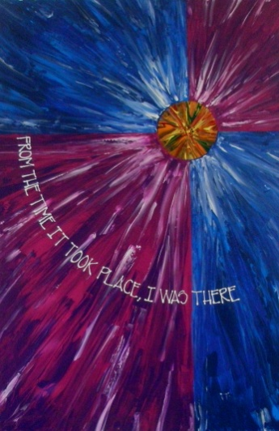
Trilogy I
Trilogy II
Media: Latex Paint and Caulk
Size: 24" x 36" each
Sale Value: $750.00 for I, II, III

Slide 15
Media: Latex Paint and Caulk Size: 24'' x 36'' Sale Value: NFS

Slide 16
Media: Latex Paint and Caulk Size: 24” x 36” Sale Value: NFS

Slide 17
Media: Latex Paint and Caulk Size: 24" x 30“ Sale Value: $295. 00

Slide 18
Media: Latex Paint and Caulk
Size: 24'' x 30''
Sale Value: $250.00

Slide 19
Media: Latex Paint and Caulk
Size: 24” x 30”
Sale Value: NFS

Slide 20
Media: Latex Paint and Caulk Size: 24" x 30" Sale Value: NFS

Slide 21
Media: Latex Paint and Caulk Size: 24’’ x 30” Sale Value: NFS

Slide 22
Media: Latex Paint and Caulk
Size: 24" x 364“
Sale Value: NFS

Slide 23
Media: Latex Paint and Caulk
Size: 24” x 36”
Sale Value: NFS

Slide 24
Media: Latex Paint and Caulk
Size: 24” x 48”
Sale Value: NFS

Slide 25
Media: Latex Paint and Caulk
Size: 24” x 48”
Sale Value: NFS

Slide 26
Media: Latex Paint and Caulk
Size: 24” x 48”
Sale Value: $275

Slide 27
Media: Latex Paint and Caulk
Size: 24” x 48”
Sale Value: $275

Slide 28
Media: Latex Paint and Caulk
Size: 24” x 48”
Sale Value: NFS

Slide 29
Media: Latex Paint and Caulk
Size: 30” x 40”
Sale Value: $395.00

Slide 30
Media: Latex Paint and Caulk
Size: 30” x 40”
Sale Value: $350.00

Slide 31
Media: Latex Paint and Caulk
Size: 30” x 40”
Sale Value: $425.00

Slide 32
Media: Latex Paint and Caulk
Size: 24” x 48”
Sale Value: NFS

Slide 33
Media: Latex Paint and Caulk
Size: 30” x 40”
Sale Value: NFS

Slide 34
Media: Latex Paint and Caulk
Size: 36” x 48”
Sale Value: NFS

Slide 35
Thank you for visiting this exhibit
If you saw something you like and are interested in purchasing a piece of artwork, please contact Paul Ditto, Executive Director of the Foundation at Lovers Lane United Methodist Church
at 214-706-9561 or email him at pditto@llumc.org
For all purchases, sales tax of 8.25% must be added. 25% of the sales price will go to the Visual Arts Endowment of the Lovers Lane Foundation and the artist will receive 75% of the purchase price. All purchased pieces must remain up in the exhibit until the end of the exhibit (July 1). They must be picked up the morning of Thursday, July 1 (and not before), unless alternative arrangements have been made with Paul Ditto.
Visual Arts Committee of the Lovers Lane Foundation

