Slide 1
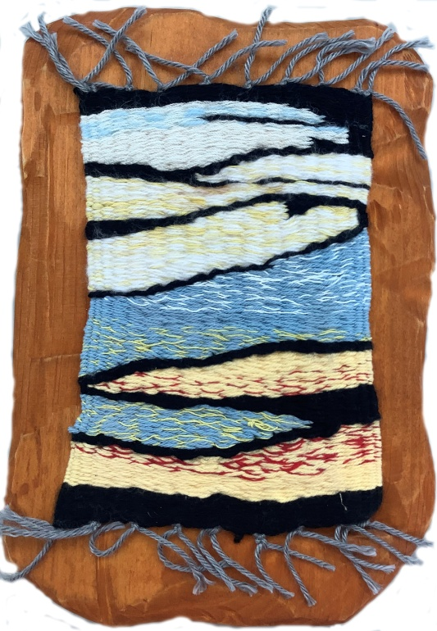
Tablet Weaving 2
Creation Date: 2013
Mixed Media Weaving and Wood
14.5” Tall
9” Wide
7/8” Deep
Sale Price: $200

Slide 2
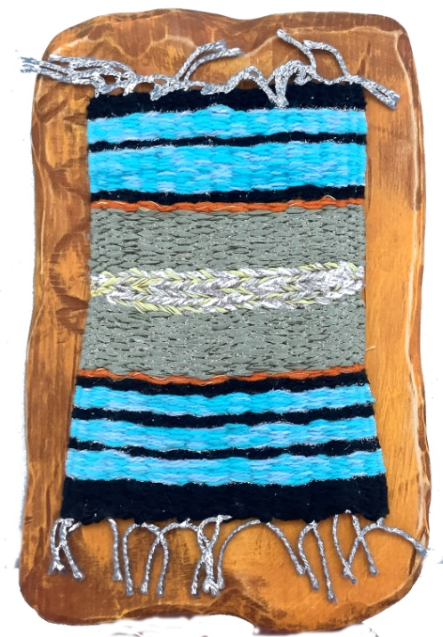
Tablet Weaving 4
Creation Date: 2013
Mixed Media Weaving and Wood
14.5” Tall
9” Wide
7/8” Deep
Sale Value: $200

Slide 3
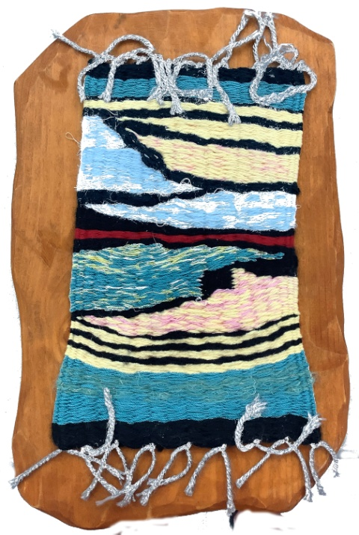
Tablet Weaving 11
Creation Date: 2013
Mixed Media Weaving and Wood
14.5” Tall
9” Wide
7/8” Deep
Sale Value: $200

Slide 4
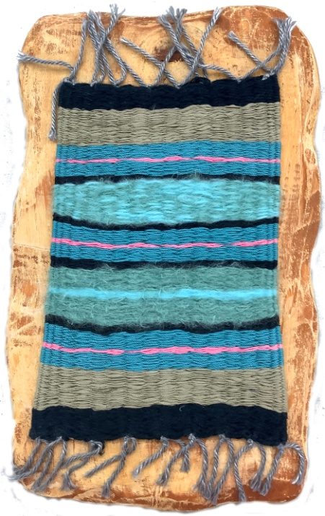
Tablet Weaving 12
Creation Date: 2013
Mixed Media Weaving and Wood
14.5” Tall
9” Wide
7/8” Deep
Sale Value: $200

Slide 5
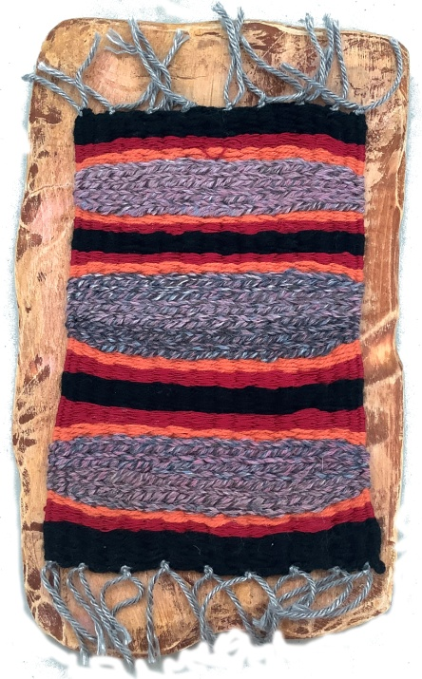
Tablet Weaving 13
Creation Date: 2013
Mixed Media Weaving and Wood
14.5” Tall
9” Wide
7/8” Deep
Sale Value: $200

Slide 6
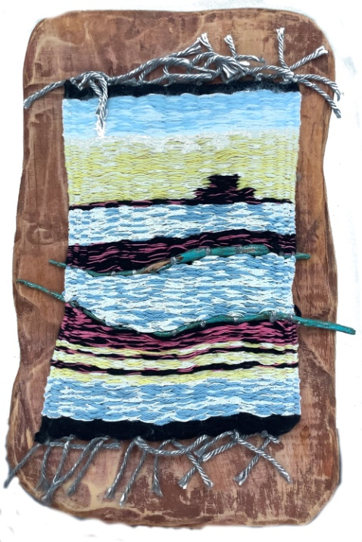
Tablet Weaving 14
Creation Date: 2013
Mixed Media Weaving and Wood
14.5” Tall
9” Wide
7/8” Deep
Sale Value: $200

Slide 7
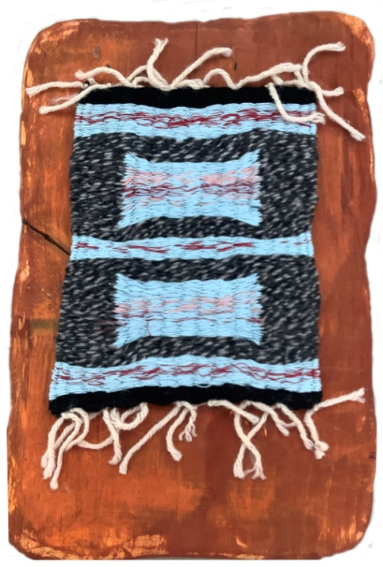
Tablet Weaving 15
Creation Date: 2012
Mixed Media Weaving and Wood
14.5” Tall
9” Wide
7/8” Deep
Sale Value: $200

Slide 8
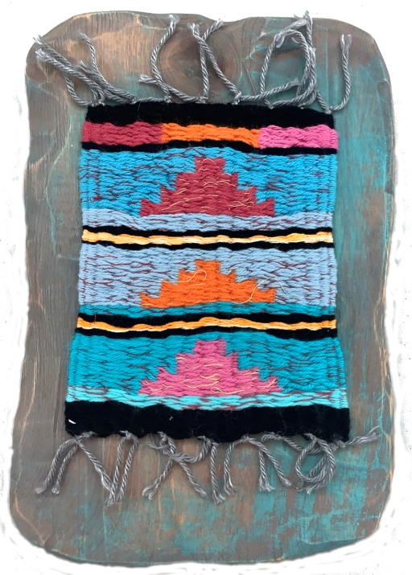
Tablet Weaving 16
Creation Date: 2012
Mixed Media Weaving and Wood
14.5” Tall
9” Wide
7/8” Deep
Sale Value: $200

Slide 9
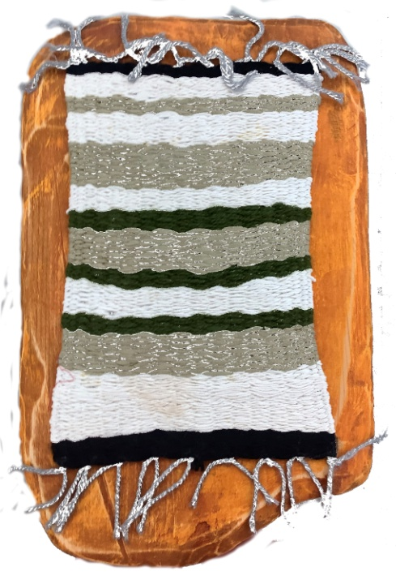
Tablet Weaving 20
Creation Date: 2013
Mixed Media Weaving and Wood
14.5” Tall
9” Wide
7/8” Deep
Sale Value: $200

Slide 10
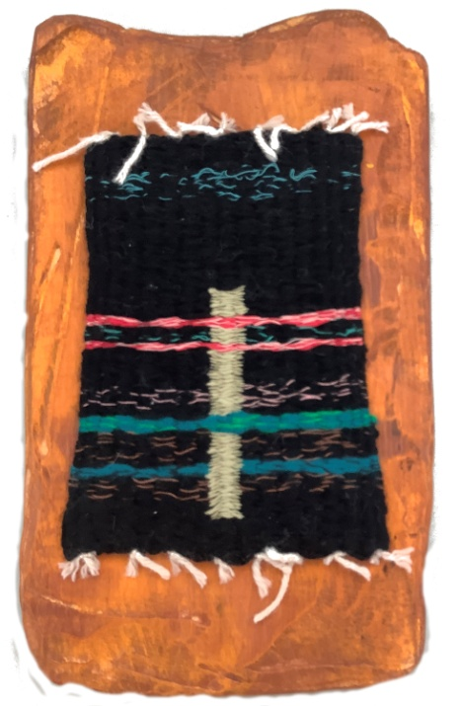
Tablet Weaving 17
Creation Date: 2012
Mixed Media Weaving and Wood
14.5” Tall
9” Wide
7/8” Deep
Sale Value: $200

Slide 11
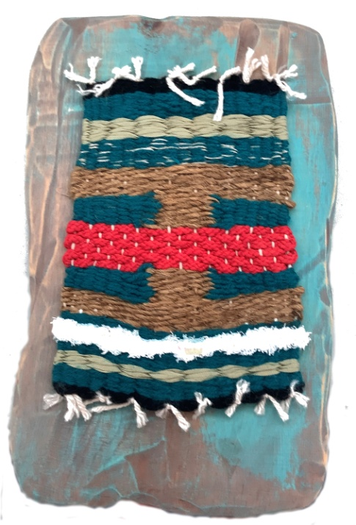
Tablet Weaving 18
Creation Date: 2012
Mixed Media Weaving and Wood
14.5” Tall
9” Wide
7/8” Deep
Sale Value: $200

Slide 12
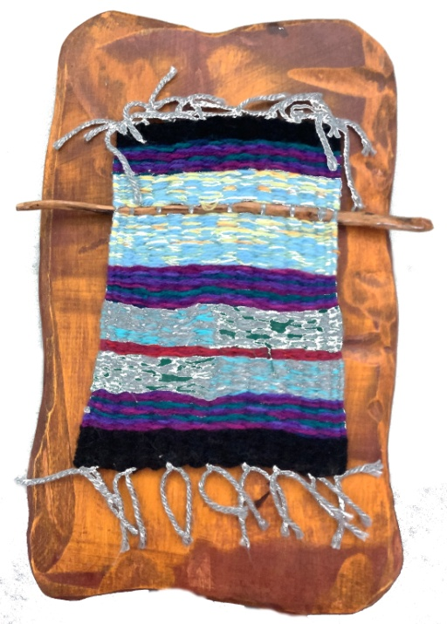
Tablet Weaving 19
Creation Date: 2012
Mixed Media Weaving and Wood
14.5” Tall
9” Wide
7/8” Deep
Sale Value: $200

Slide 13
Mixed Media Weaving 22
Creation Date: 2018
Mixed Media Weaving and wood
24” Tall
12” Wide
1.5” Deep
Sale Value: $350

Slide 14
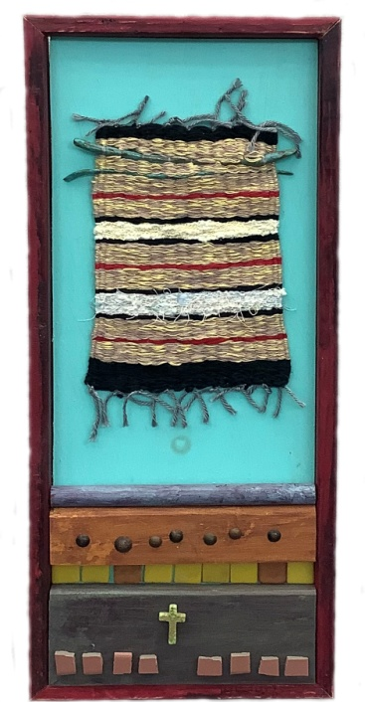
Mixed Media Weaving 15
Creation Date: 2015
Mixed Media Weaving
25” Tall
10.5” Wide
1.5” Deep
Sale Value: $350

Slide 15
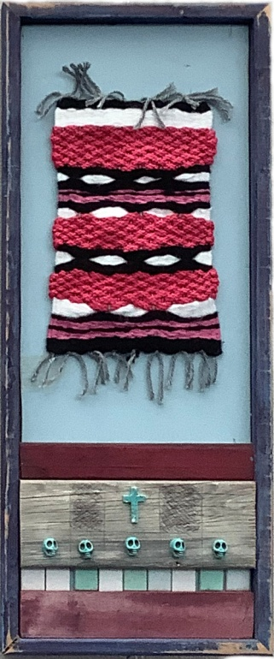
Mixed Media Weaving 23
Creation Date: 2014
Mixed Media Weaving
25” Tall
10.5” Wide
1.5” Deep
Sale Value: $350

Slide 16
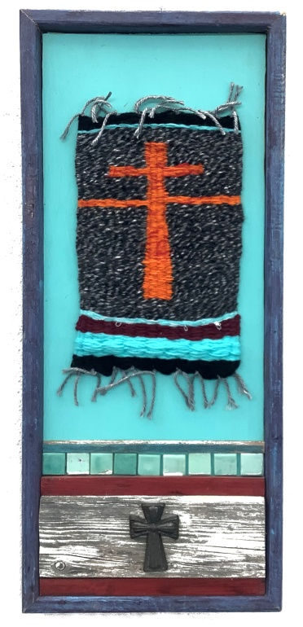
Mixed Media Weaving 12
Creation Date: 2018
Mixed Media Weaving
25” Tall
10.5” Wide
1.5” Deep
Sale Value: $350

Slide 17
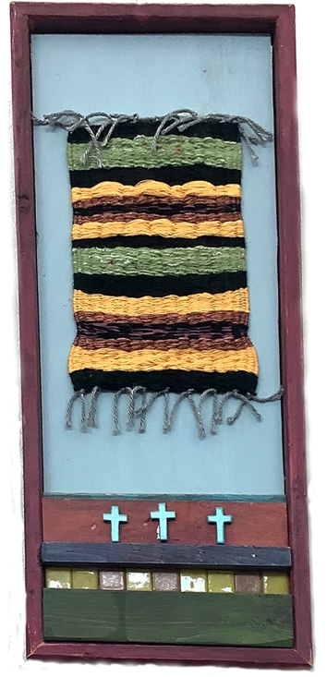
Mixed Media Weaving 11
Creation Date: 2018
Mixed Media Weaving
25” Tall
10.5” Wide
1.5” Deep
Sale Value: $350

Slide 18
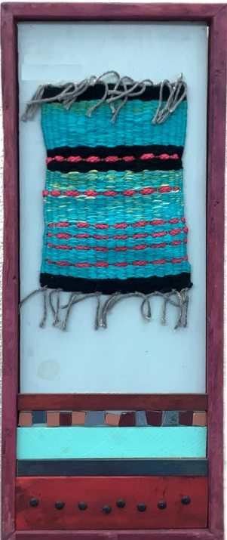
Mixed Media Weaving 10
Creation Date: 2015
Mixed Media Weaving
25” Tall
10.5” Wide
1.5” Deep
Sale Value: $350

Slide 19
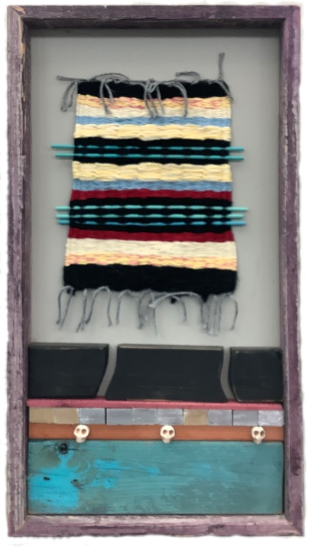
Mixed Media Weaving 21
Creation Date: 2015
Mixed Media Weaving
24” Tall
12” Wide
1.5” Deep
Sale Value: $350

Slide 20
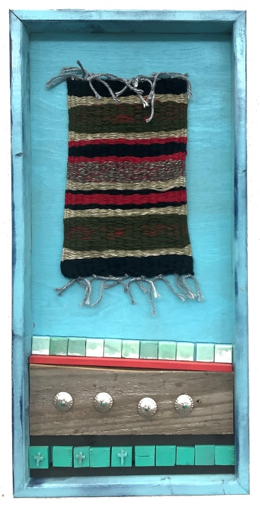
Mixed Media Weaving 19
Creation Date: 2015
Mixed Media Weaving
24” Tall
12” Wide
1.5” Deep
Sale Value: $350

Slide 21
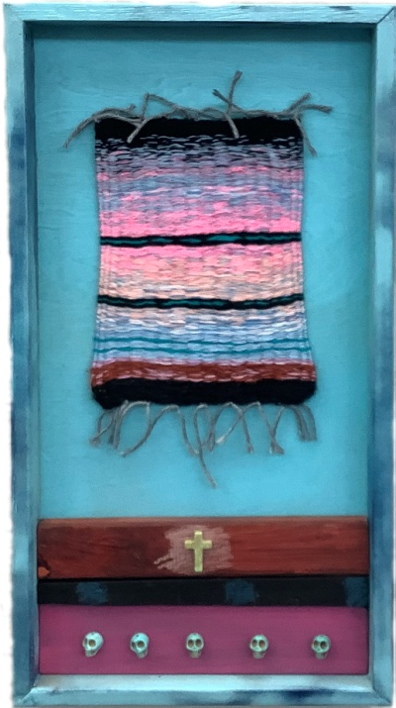
Mixed Media Weaving 16
Creation Date: 2017
Mixed Media Weaving
24” Tall
12” Wide
1.5” Deep
Sale Value: $350

Slide 22
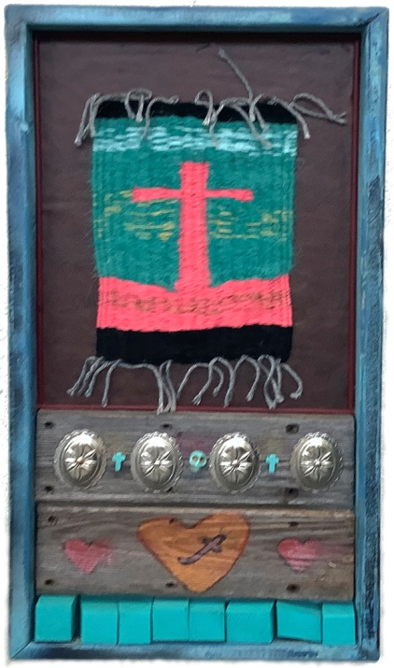
Mixed Media Weaving 4
Creation Date: 2018
Mixed Media Weaving
24” Tall
12” Wide
1.5” Deep
Sale Value: $350

Slide 23
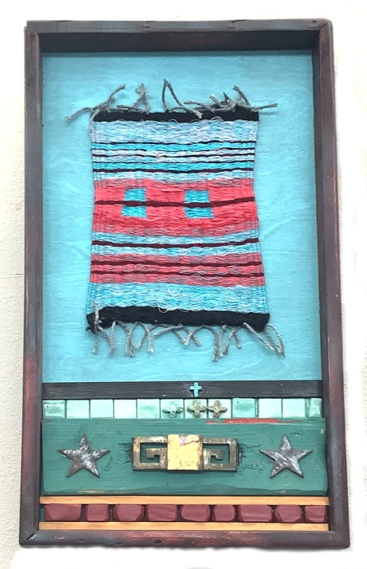
Mixed Media Weaving 3
Creation Date: 2019
Mixed Media Weaving
24” Tall
12” Wide
1.5” Deep
Sale Value: $350

Slide 24
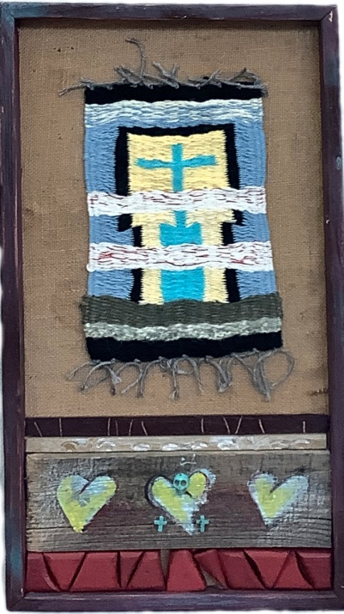
Mixed Media Weaving 5
Creation Date: 2019
Mixed Media Weaving
24” Tall
12” Wide
1.5” Deep
Sale Value: $350

Slide 25
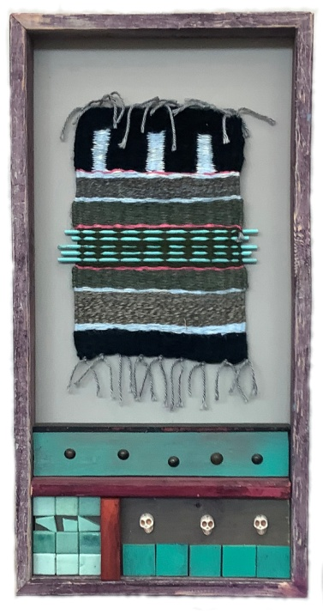
Mixed Media Weaving 18
Creation Date: 2015
Mixed Media Weaving
24” Tall
12” Wide
1.5” Deep
Sale Value: $350

Slide 26
Mixed Media Weaving 17
Creation Date: 2017
Mixed Media Weaving
24” Tall
12” Wide
1.5” Deep
Sale Value: $350

Slide 27
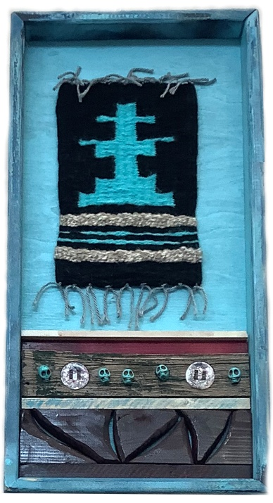
Mixed Media Weaving 15
Creation Date: 2018
Mixed Media Weaving
24” Tall
12” Wide
1.5” Deep
Sale Value: $350

Slide 28
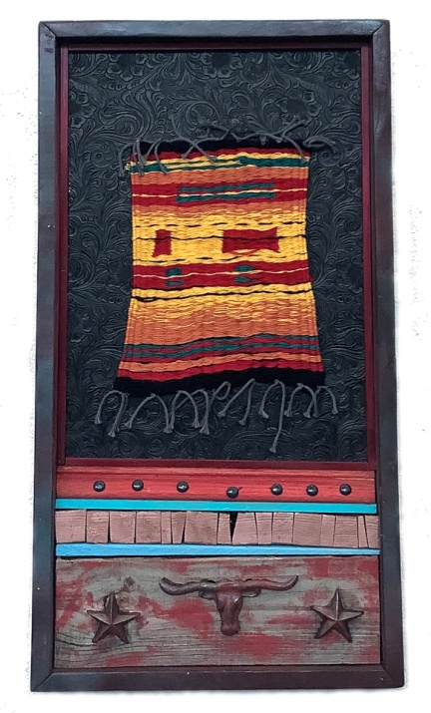
Mixed Media Weaving 6
Creation Date: 2019
Mixed Media Weaving
24” Tall
12” Wide
1.5” Deep
Sale Value: $350

Slide 29
Mixed Media Weaving 2
Creation Date: 2019
Mixed Media Weaving
24” Tall
12” Wide
1.5” Deep
Sale Value: $350

Slide 30
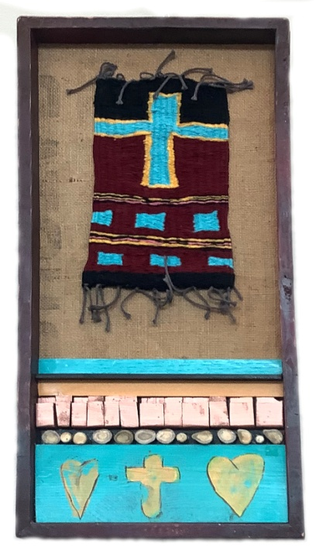
Mixed Media Weaving 20
Creation Date: 2019
Mixed Media Weaving
24” Tall
12” Wide
1.5” Deep
Sale Price: $350

Slide 31
“One Can Help the Other” The title of this show comes from Ecclesiastes 4:10 “If either of them falls down, one can help the other up. But pity anyone who falls and has no one to help them up.”
Come Visit
William Keith’s Art Exhibit
At the ArtReach Gallery in Watson Hall
Of Lovers Lane United Methodist Church
9200 Inwood Rd., Dallas, TX 75220 Sponsored by
The Visual Arts Committee of the
Lovers Lane United Methodist Church Foundation

Slide 32
The ArtReach Gallery Sponsored by the Visual Arts Committee of the Lovers Lane Foundation
See something you like? If you are interested in purchasing a piece of artwork, please contact Paul Ditto, Executive Director of the Lovers Lane Foundation
214-706-9561 or email him at pditto@llumc.org For all purchases, 8.025% is added for Sales Tax.
25% of the sale proceeds will go to the Visual Arts Endowment
of the Lovers Lane Foundation
and the artist will receive 75% of the sale proceeds
Purchased Pieces can be picked up on
November 19 (not sooner)
If you require it shipped, let us know and we will get you estimate of the shipping cost

